Slide 1
Sorting, Runtime and recurrence
CS340

Slide 2
Algorithms
An algorithm is any well-defined computational procedure that takes some value, or set of values, as input and produces some value, or set of values, as output.

Slide 3
Sorting: Insertion Sort
Input
a sequence of n numbers <a₁, a₂, a₃, … a_{n}>
Output
a reordering <a₁', a₂', a₃', … a_{n}'> of the input sequence such that a₁' ≤ a₂' ≤ a₃' ≤ … ≤ a_{n}'>
Often the numbers are stored in an array, A

Slide 4
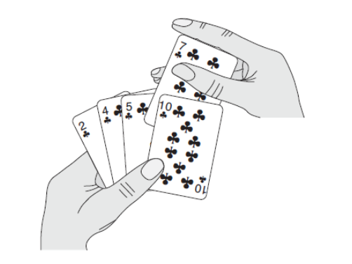
Insertion Sort

Slide 5
Insertion Sort
The idea is to insert the current element into a sub-array that is assumed to be sorted.
What we need:
A loop L1 going through the elements A[i]
Within L1 we need to perform insertion of
the current element A[i] within already sorted sub-array A[1], … ,A[i-1]

Slide 6
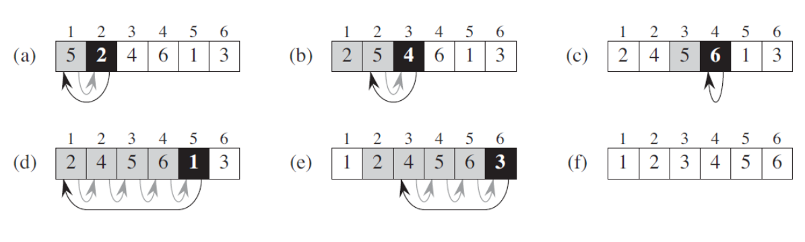
Insertion Sort
(c) no elements are moved
(d) all elements are moved

Slide 7
Insertion Sort
If A[i] is already in the “correct position”
No extra “insertion” needed
What it means: A[i] > A[i-1]
Namely, when A[i] is the maximum of the subarray
On the other hand, if A[i] is the minimum of the subarray
Namely, when A[i] < A[1]
Then, A[i] needs to be inserted into the first index.
Entire subarray must be right-shifted.

Slide 8
Insertion Sort
The larger A[i] is in comparison to subarray A[1]…A[i-1]
The smaller the amount of right-shifting.
Whereas L1 goes left to right through the A[i]
There is an inner loop L2
used for insertion into subarray
which goes right to left

Slide 9
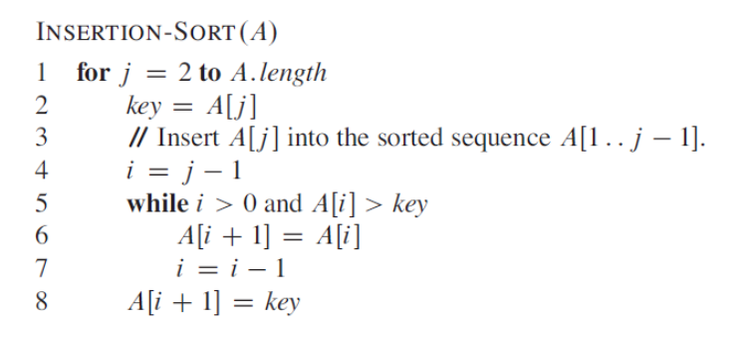
Insertion Sort

Slide 10
Proving correctness with a loop invariant
3 Things must be shown
Initialization: It is true prior to the first iteration of the loop.
Maintenance: If it is true before an iteration of the loop, it remains true before the next iteration.
Termination: When the loop terminates, the invariant—usually along with the reason that the loop terminated—gives us a useful property that helps show that the algorithm is correct.

Slide 11
Loop invariant for insertion sort
Loop invariant: At the start of each iteration of the “outer” for loop—the loop indexed by j—the subarray A[1.. j-1] consists of the elements originally in A[1.. j-1] but in sorted order.

Slide 12
Correctness of insertion sort
Initialization
Just before the first iteration, j = 2. The subarray A[1.. j-1] is the single element A[1], which is trivially sorted.
Maintenance:
The body of the inner while loop works by moving A[j-1], A[j-2], A[j-3], and so on, by one position to the right until the proper position for key (which has the value that started out in A[j]) is found. At that point, the value of key is placed into this position. The subarray A[1..j] then consists of the elements originally in A[1..j], but in sorted order.
Termination:
The outer for loop ends when j > n, which occurs when j=n+1. Therefore, j-1=n. Plugging n in for j-1 in the loop invariant, the subarray A[1..n] consists of the elements originally in A[1..n] but in sorted order. In other words, the entire array is sorted.

Slide 13
Interview Questions
Rewrite the INSERTION-SORT procedure to sort into nonincreasing instead of nondecreasing order.
Write a pseudocode for LINEAR-SEARCH, which scans through the sequence, looking for v. Using a loop invariant, prove that your algorithm is correct. (Make sure that your loop invariant fulfills the three necessary properties – initialization, maintenance, termination.)
LINEAR-SEARCH(A, v)
for i = 1 to A.length
if A[i] == v
return i
return NIL

Slide 14
Analyzing algorithms
We want to predict the resources that the algorithm requires.
This is usually running time.
Asymptotic analysis
Comparison of functions as inputs approach infinity.
Asymptotic efficiency
How the running time of an algorithm increases with the size of the input, as the size of the input increases without bound.

Slide 15
Efficiency and Complexity
If we want to contrast methods in terms of efficiency
we must sooner or later formalize complexity.
How to calculate: “How long does a program take?”
The same algorithm may produce different run times
The same program running on different machines will take longer on the slower machine!
Different programming languages may take different times
We need a machine-independent measure

Slide 16
Time complexity
Each programming statement has a cost
Adding 2 numbers uses a certain number of processing cycles
Making a comparison uses some number of processing cycles
Each programming statement is run some number of times
The running time of the algorithm is the sum of running times for each statement executed
A statement that takes c_{i} steps to execute and executes n times will contribute c_{i}n to the total running time.

Slide 17
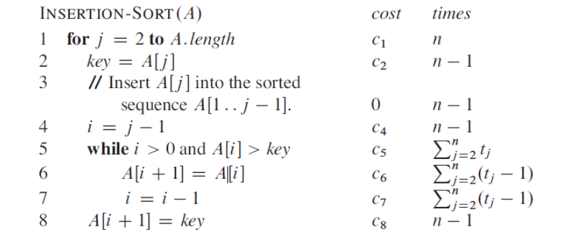
Total Cost = cost x times
t_{j} denotes the number of times the while loop test in line 5 is executed for that value of j.
The test for a loop is executed one more time than the loop.

Slide 18
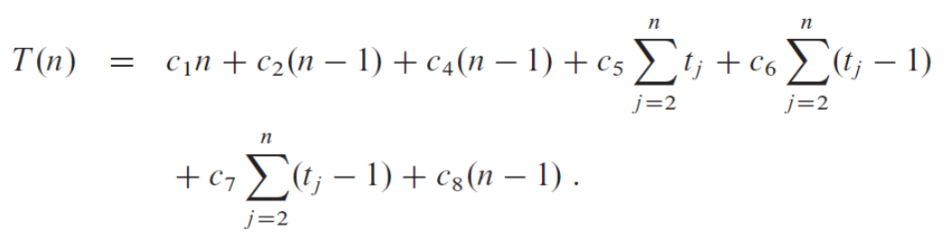
Running time for Insertion Sort

Slide 19
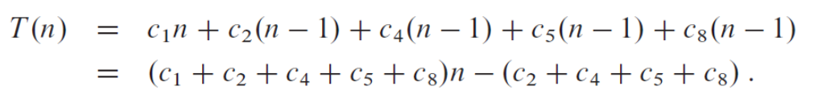
Running time for Insertion Sort
Best case: the while loop is never run
= an + b
= linear time based on size of input. Size of input = n.

Slide 20
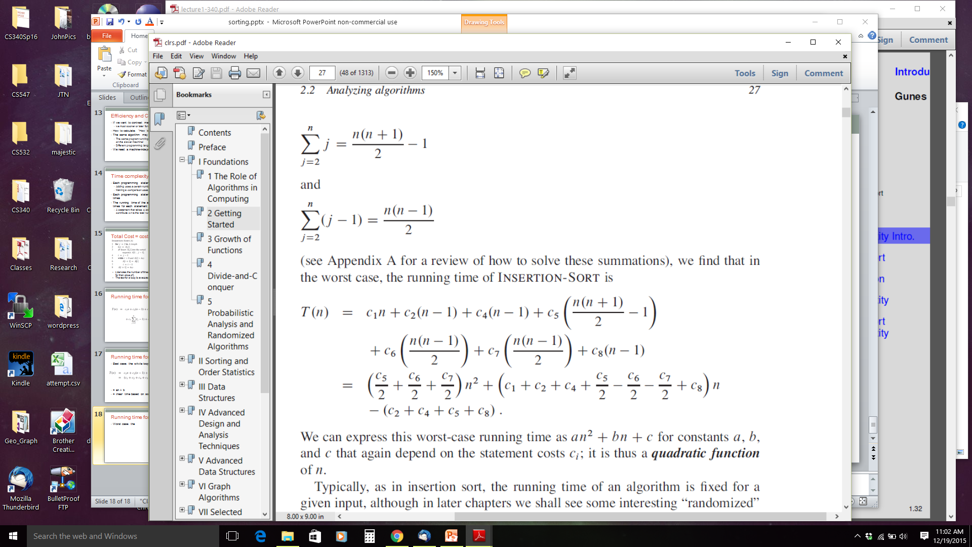
Running time for Insertion Sort
Worst case: the while loop runs the maximum number of times every time.
= an² + bn + c
= quadratic time based on size of input

Slide 21
Time complexity
We will focus on the worst case
The worst case is an upper bound on the total time
What did the best case of insertion sort tell us?
Why care about the worst case?
The worst case can be roughly as bad as the average case
What is the average case for insertion sort?
However, we are luckier with some algorithms (e.g. QuickSort).
For critical applications, you want a guarantee on the running time even when you know nothing about the input.

Slide 22
One more abstraction
It is the rate (or order) of growth we are interested in
We can simplify to the order of n, where n is size of input
an + b → Θ(n) (pronounced theta of n) = linear time
an² + bn + c → Θ(n²) (pronounced theta of n-squared)

Slide 23
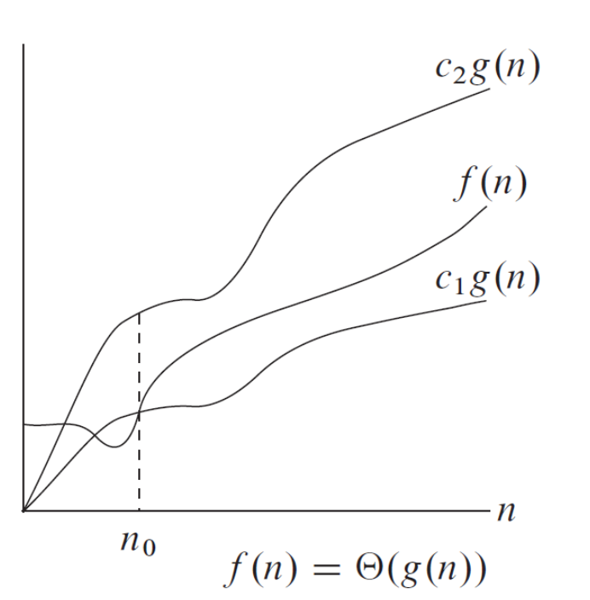
Theta Notation
Θ(g(n)) = { f(n): there exist positive constants c₁, c₂, and n₀ such that
0 ≤c₁g(n)≤ f(n) ≤ c₂g(n) for all n ≥ n₀}

Slide 24
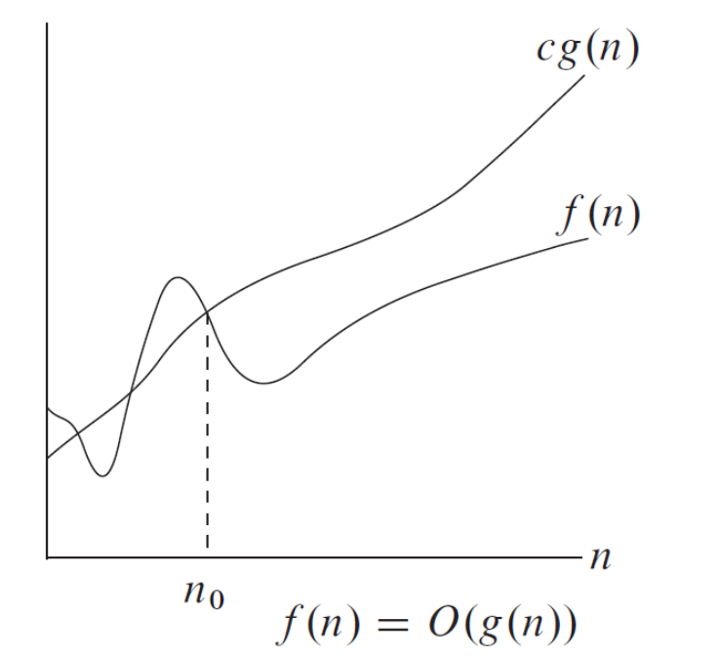
O-Notation
O(g(n)) = { f(n): there exist positive constants c and n₀ such that
0 ≤ f(n) ≤ cg(n) for all n ≥ n₀}
Θ(g(n))⊆ O(g(n))
Θ-notation is a stronger notion
than O-notation.

Slide 25
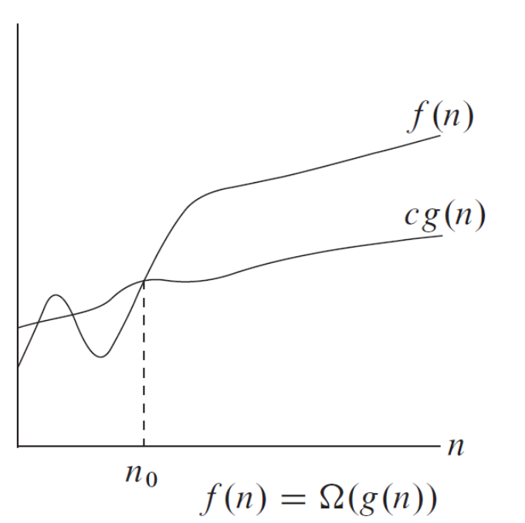
Omega-Notation
Ω(g(n)) = { f(n): there exist positive constants c and n₀ such that
0 ≤cg(n)≤ f(n) for all n ≥ n₀}
Ω –notation provides an
asymptotic lower bound.

Slide 26
Interview Questions
Express the function n³/1000 + 100n² - 100n + 3 in terms of Θ-notation.
Consider linear search.
How many elements of the input sequence need to be checked on the average, assuming that the element being searched for is equally likely to be any element in the array?
How about in the worst case?
How about in the best case?
What are the average-case and worst-case running times of linear search in Θ-notation?
How can we modify almost any algorithm to have a good best-case running time?

Slide 27
Interview Questions
Show that for any real constants a and b, where b > 0,
(n+a)^{b} = Θ(n^{b})

Slide 28
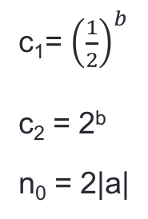
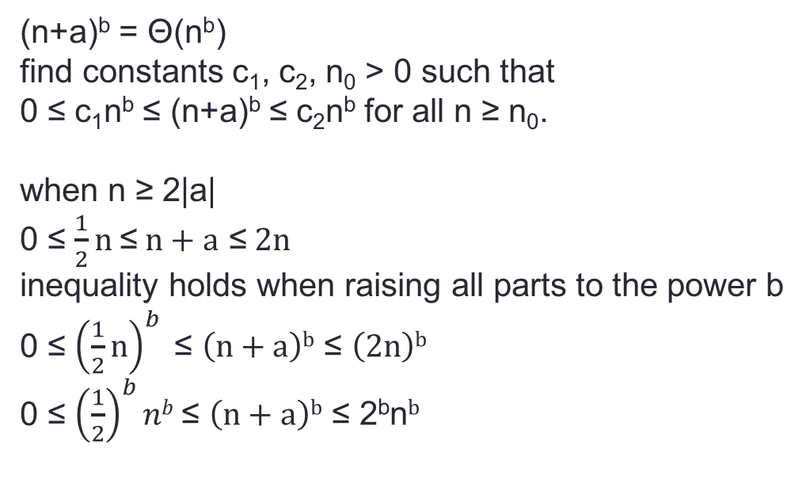
Interview Questions
(n+a)^{b} = Θ(n^{b})
find constants c₁, c₂, n₀ > 0 such that
0 ≤ c₁n^{b} ≤ (n+a)^{b} ≤ c₂n^{b} for all n ≥ n₀.
when n ≥ 2|a|
0 ≤ $\frac{1}{2}n \text{≤} n+a \text{≤} 2n$
inequality holds when raising all parts to the power b
0 ≤ ${\left(\frac{1}{2}n\right)}^{b} \text{≤} \left(n+a\right)b \text{≤} \left(2n\right)b$
0 ≤ ${\left(\frac{1}{2}\right)}^{b}nb \text{≤ }\left(n+a\right)b \text{≤}\text{ 2}\text{b}\text{n}b$
c₁= ${\left(\frac{1}{2}\right)}^{b}$
c₂ = 2^{b}
n₀ = 2|a|

Slide 29
Merge Sort
Insertion sort is incremental: the first part of the array is sorted. Keep it sorted when adding a new number.
Another technique for developing algorithms is divide and conquer.
Divide and conquer
divides a problem into smaller subproblems (divide)
solves those subproblems (conquer)
combines the results (combine)

Slide 30
Merge Sort
To sort A[p..r]
Divide by splitting into two subarrays A[p..q] and A[q+1..r], where q is the halfway point of A[p..r].
Conquer by recursively sorting the two subarrays A[p..q] and A[q+1..r].
Combine by merging the two sorted subarrays A[p..q] and A[q+1..r] to produce a single sorted subarray A[p..r].

Slide 31
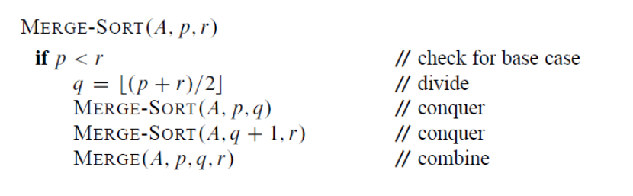
Merge Sort
Initial call: Merge-Sort(A, 1, n)

Slide 32
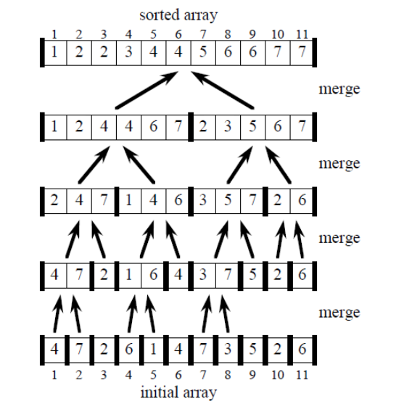
Merge Sort

Slide 33
The Merge Procedure
Input: Array A and indices p, q, r such that
p ≤ q < r.
Subarray A[p..q] is sorted and subarray A[q+1..r] is sorted. By the restrictions on p, q, r, neither subarray is empty.
Output: The two subarrays are merged into a single sorted subarray in A[p..r].

Slide 34
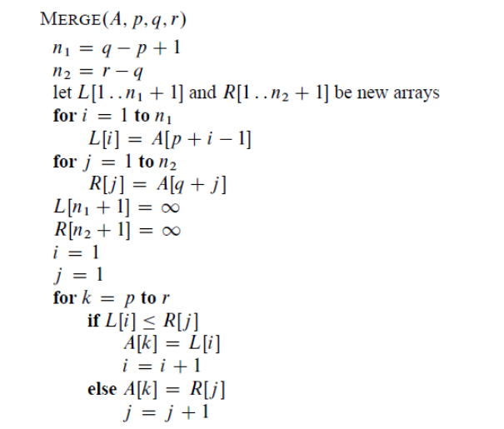
Merging two sorted arrays
What is the time complexity of
Merge() ?

Slide 35
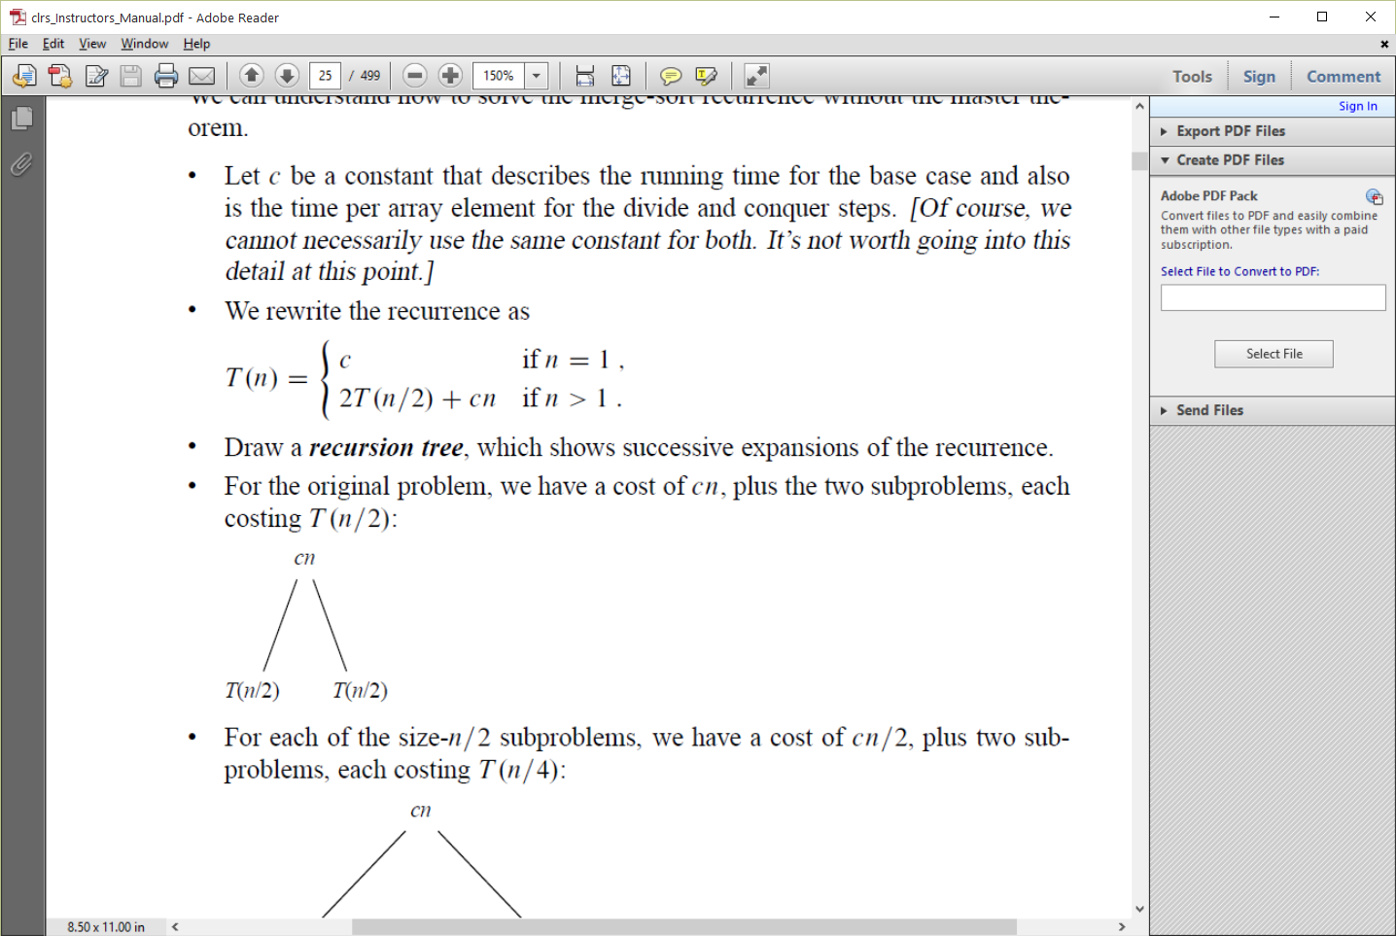
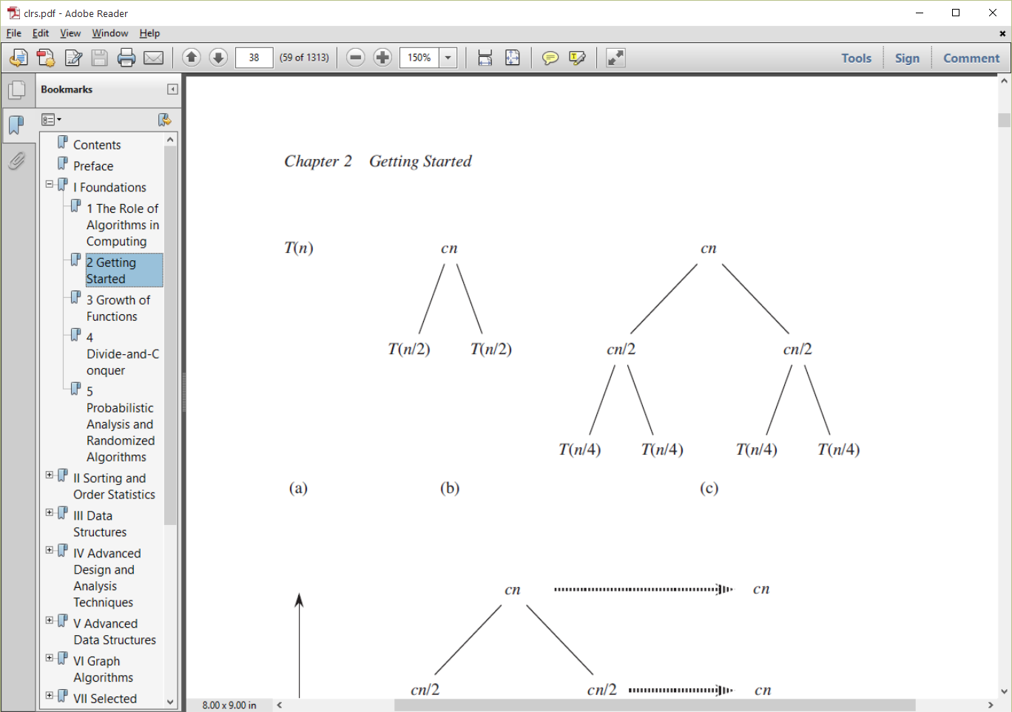
Time complexity of Merge Sort
Describe the complexity with
a recurrence equation →
Draw a recursion tree

Slide 36
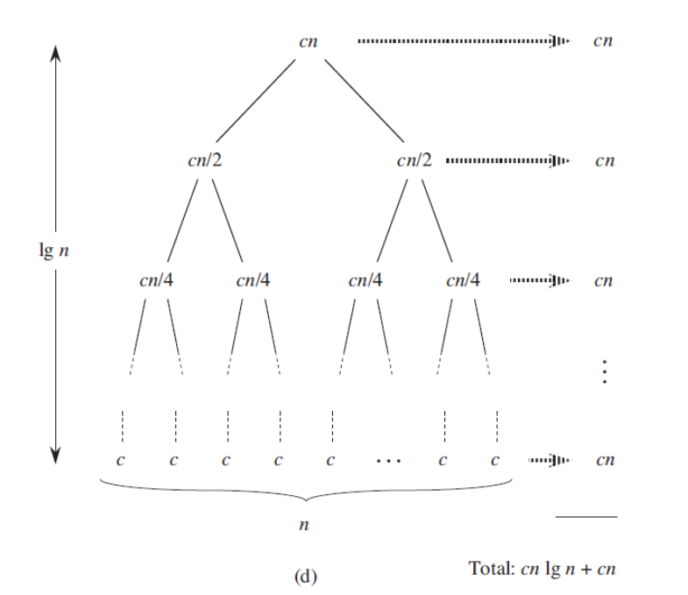
Complexity of Merge Sort
How many levels is the tree?
What is the cost at each level?
Complexity =
Θ(n lg n)
How does this compare to insertion sort?

Slide 37
Recursive Insertion Sort
Base Case
Key is slot 2. The first item is trivially sorted
Otherwise
recursively sort A[1..i-1] and then insert A[i] into the sorted array A[1..i-1]

Slide 38
Recursive Insertion Sort
private static int sort(int[] A, int maxIndex) {
if (maxIndex <= 1) {
return maxIndex;
}
maxIndex = sort(A, maxIndex - 1); // recursive call
int key = A[maxIndex];
int i = maxIndex - 1;
while ((i >= 0) && (A[i] > key)) {
A[i+1] = A[i];
i--;
}
A[i+1] = key;
return maxIndex + 1;
}

Slide 39
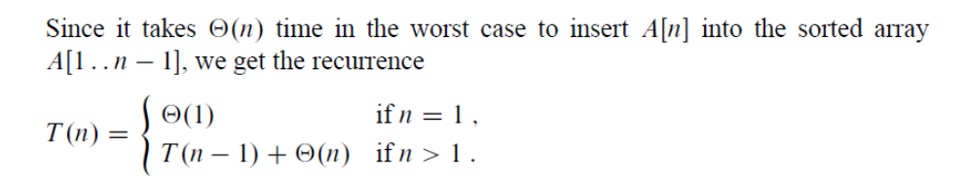
Recurrence for Recursive Insertion Sort
T(n) = Θ(n²)

Slide 40
Binary Search
If the sequence A is sorted, we can check the midpoint of the sequence against a desired value and eliminate half of the sequence from further consideration.
Binary search repeats this procedure, halving the size of the remaining portion of the sequence each time.
Notes:
worst case: lg n = max number of comparisons
best case: O(1) the number searched for = n/2

Slide 41
Binary Search
int Binary_Search (vector<int> v, int from, int to, int val) {
if (from>to) return -1; //val not found
int mid = (from+to)/2;
if (v[mid] == val)
return mid;
else if (val > v[mid])
return Binary_Search(v,mid+1,to,val);
else
return Binary_Search(v,from,mid-1,val);
}

Slide 42
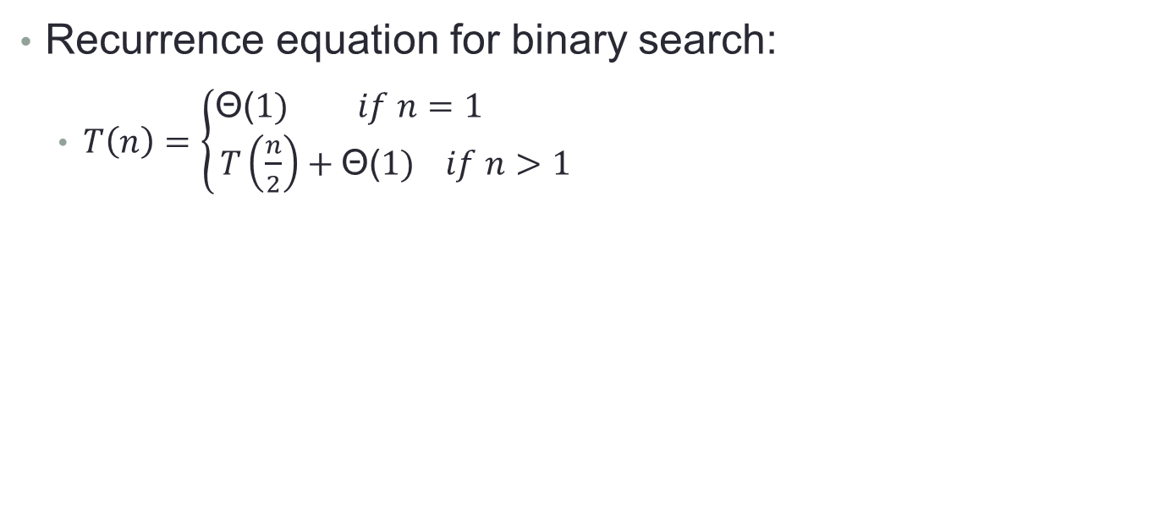
Binary Search
Recurrence equation for binary search:
$T\left(n\right)=\left\{\begin{aligned}\text{Θ}\text{(}1) if n=1 \\ T\left(\frac{n}{2}\right)+\text{Θ}\text{(}1) if n>1\end{aligned}\right.$
What is the worst-case running time of binary search?
What is the best-case running time of binary search?
What is the theta for binary search?
Notes:
worst-case = $\text{Θ}$(lg n)
best case = $\text{Θ}\text{(1)}$
Theta = $\text{Θ}$(lg n)

Slide 43
Binary-Search enhanced Insertion Sort
Use binary search to find the insertion point of the key.
Does this improve the running time (theta) of Insertion Sort?
Notes:
No, even if you find the insertion point more quickly, n items must still be shifted to the right.

Slide 44
Interview Questions
Describe a Θ(n lg n)-time algorithm that, given a set S of n integers and another integer x, determines whether or not there exist two elements in S whose sum is exactly x.
What do you think of when you hear Θ(n lg n)?
What is the "naïve" way of doing this? (and its theta?)

Slide 45
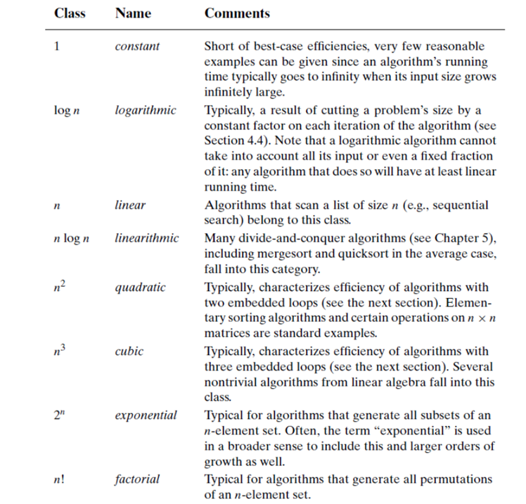
Basic Asymptotic Efficiency Classes

Slide 46
Basic Asymptotic Efficiency Classes

Slide 47
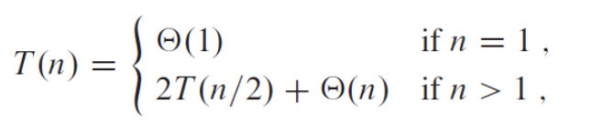
Recurrences
An equation that describes a function in terms of its value on smaller inputs
How to solve?
Substitution Method = "guess then prove"
Recursion Tree
Master Method = Memorize cases of T(n) =aT(n/b) +f(n)

Slide 48
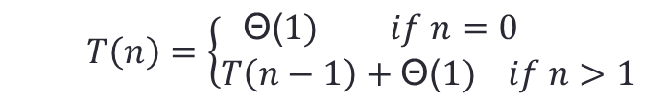
Practice with recursion and recurrences
RM1(n)
1 if n = 0
2 return 0
3 else
4 return 1 + RM1(n - 1)
$$T\left(n\right)=\left\{\begin{aligned}\text{Θ}\text{(}1) if n=0 \\ T\left(n−1\right)+\text{Θ}\text{(}1) if n>1\end{aligned}\right.$$
What does this function do?
What is its theta?
Notes:
It returns n
Θ(n)

Slide 49
Practice with recursion and recurrences
RM3(n)
1 if n = 0
2 return 0
3 else
4 return n + RM3(n - 1)
$$T\left(n\right)=\left\{\begin{aligned}\text{Θ}\text{(}1) if n=0 \\ T\left(n−1\right)+\text{Θ}\text{(}1) if n>1\end{aligned}\right.$$
What does this function do?
What is its theta?
Is there a Θ(1) way to do this?
Notes:
It returns the sum of x=0 to n
Θ(n)

Slide 50
Practice with recursion and recurrences
factorial(n)
1 if n = 0
2 return 1
3 else
4 return n * factorial(n - 1)
$$T\left(n\right)=\left\{\begin{aligned}\text{Θ}\text{(}1) if n=0 \\ T\left(n−1\right)+\text{Θ}\text{(}1) if n>1\end{aligned}\right.$$
What does this function do?
What is its theta?
Notes:
It returns the factorial
still Θ(n)

Slide 51
Practice with recursion and recurrences
RM4(a, n)
1 if n = 0
2 return 1
3 else
4 return a * RM4(a, n - 1)
$$T\left(n\right)=\left\{\begin{aligned}\text{Θ}\text{(}1) if n=0 \\ T\left(n−1\right)+\text{Θ}\text{(}1) if n>1\end{aligned}\right.$$
What does this function do?
What is its theta?
Notes:
It returns a^{n}
Θ(n)

Slide 52
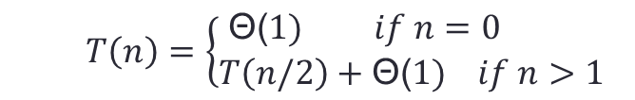
Practice with recursion and recurrences
RM6(a, n)
1 if n = 0
2 return 1
3 else if n mod 2 = 0
4 return (RM6(a, n/2))²
5 else
6 return a*(RM6(a, n/2))²
$$T\left(n\right)=\left\{\begin{aligned}\text{Θ}\text{(}1) if n=0 \\ T\left(n/2\right)+\text{Θ}\text{(}1) if n>1\end{aligned}\right.$$
What does this function do?
What is its theta?
Notes:
It returns a^{n}
Θ(lg n)

Slide 53
Common Recurrences
T(n) = T(n/2) + Θ (1) binary search Θ(log n)
T(n) = T(n-1) + Θ (1) linear search Θ(n)
T(n) = 2T(n/2) + Θ (1) tree traversal Θ(n)
T(n) = 2T(n/2) + Θ (n) merge sort Θ(n log n)
T(n) = T(n-1) + Θ (n) selection sort Θ(n²)

Slide 54
Interview Questions
Although merge sort runs in Θ(n lg n) worst-case time and insertion sort runs in Θ(n²) worst-case time, the constant factors in insertion sort can make it faster in practice for small problem sizes on many machines. Thus, it makes sense to coarsen the leaves of the recursion by using insertion sort within merge sort when subproblems become sufficiently small. Consider a modification to merge sort in which n/k sublists of length k are sorted using insertion sort and then merged using the standard merging mechanism, where k is a value to be determined.
Show that insertion sort can sort the n/k sublists, each of length k, in Θ(nk) worst-case time.
b. Show how to merge the sublists in Θ(n lg n/k) worst-case time.
c. Given that the modified algorithm runs in Θ(nk + n lg(n/k)) worst-case time, what is the largest value of k as a function of n for which the modified algorithm has the same running time as standard merge sort, in terms of Θ-notation?
d. How should we choose k in practice?

